Slide 1



Language identification from speech
Presented by
2K20/EC/186Sandeep Kumar
2K20/EC/236 Vishu

Slide 2

INTRODUCTION
Language identification (LiD) refers to the process of automatically identifying the language of a given text or spoken sample
People have become closer as a result of globalization
Making a common medium necessary for efficient communication.
By using machine learning techniques, the system will handle multiple languages, with high accuracy, including English, Japanese, French, Hindi, and Kannada.
The project’s success depends on identifying.

Slide 3
Overview of the LID System
The LID system uses a combination of machine learning Techniques and features extraction methods to identify languages.
Language Identification (Lid) recognizes the language used in a speech . The project focuses on identifying features from speech signals to distinguish languages using an acoustic model.
LID research aims to efficiently replicate the language discriminating human ability through computational means

Slide 4

Problem statement
1.The system should determine the language of a speech regardless of the speaker’s gender or accent, focusing on Hindi, Kannada, French, Japanese, and English.
It should develop over time, enhancing precision and integrating machine learning methodologies.
The system uses Mel Frequency cepstral coefficients(MFCC) as the main features and support vector machines (SVM) for classification.

Slide 5

Literature Survey
Overview of the research on Lid, focusing on Phonotactic, prosodic, and acoustic techniques.
Phonotactic techniques: Model phoneme sequences in various languages using LVASR system. It focus on intonation, rhythm, and pitch to capture language-specific aspects of speech.
Acoustic Techniques capture essential characteristics of speech signals using features like MFCC, LPC, and PLPCC.
MFCC is a standard components in voice recognition and language identification system.

Slide 6

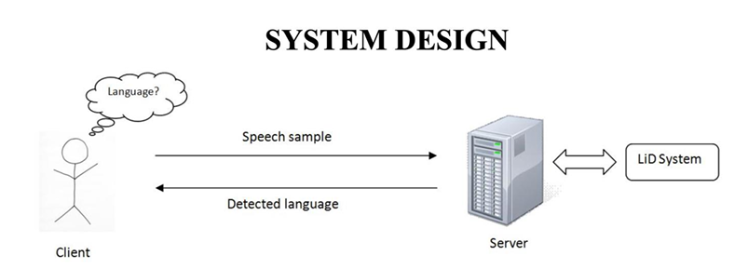
System design
Client- server architecture: Client submit speech sample, server determines languages.
Three primary components: Pre-Processing, features Extraction, Machines learning.
Pre-Processing: format conversion, resampling, and noise reduction.
Features extraction: compute MFCCs using various transformations
Machines learning: SVM classification using extracted features.

Slide 7
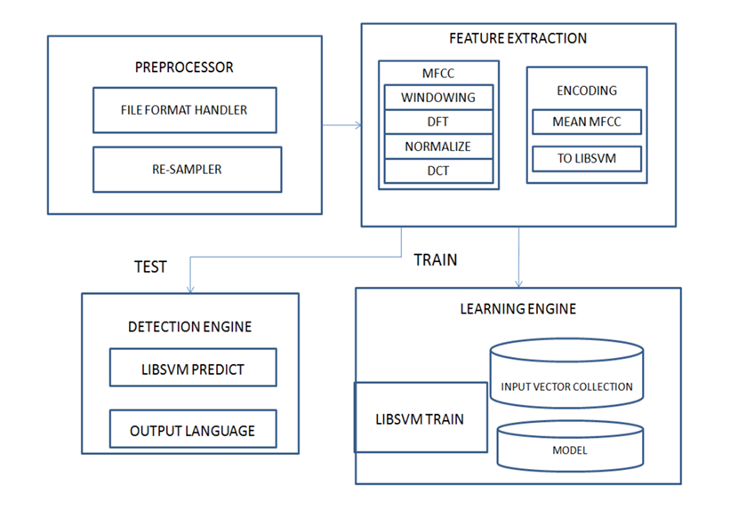

Slide 8
Implementation and Result
Overview of the implementation of the Lid system using python and audio features extraction libraries.
The recommended technique uses python bindings to extract audio features.
Libraries extract mean MFCC values for the given sample.
Stages include generate_MFCC,SVM_Training, and SVM_Predict

Slide 9
Implementation Algorithm
Vector=generate_MFCC(CepsNbCoeffs=20,blockSize=1024, stepSize=2048, computeMean=True, MFCC:Window= Hamming)
ALGORITHM Vector SVM_Training
Input: Cepstral data-containing support vectors
Model: svm-tain(vector,kernel: RBF, type: C-SVM.
SVM Predict Algorithm
Lacks in performance and reach

Slide 10

The system connects agents to callers more quicky, leading to shorter wait times and smoother interactions.
Improves overall performance of the call center, contributing to higher customer retention and loyalty.
Case Study 1: Multilingual Call Center (cont.)

Slide 11

Case study 2: Language Learning App
Background: A Language Learning app supports multiple language.
Challenge: Personalize the Learning experience by detecting the language spoken during practice sessions.
Sollution: Language detection module using CNNs and RNNs.
Results: Customized learning experiences and targeted feedback enhances user engagement.

Slide 12

Case Study 3: Security and Authentication System
Background : A Financial institution uses Voice- based authentication for account access.
Challenges: Accurate languages detetion to ensure robust security.
Solution: Spoken Language detection module using machine learning algorithms.
Results: Enhanced security and reliability of the authentication system.

Slide 13

Performance Analysis
E
Datasets from online sources are used for testing.
N-fold cross-validation to assess the system thoroughly.
Result displayed as a confusion matrix.
Accuracy for each language:
98.558% in English
97.0065% in French
91.79% in Hindi
96.42% in Kannada
98.3302% in Japanese
Overall accuracy : 96.42%

Slide 14
Conclusions
The proposed LiD system performs expectionally well in spoken language recognition.
High accuracy rates demonstrate robustness and dependability.
Further development may be required for specific issues and increased accuracy.

Slide 15
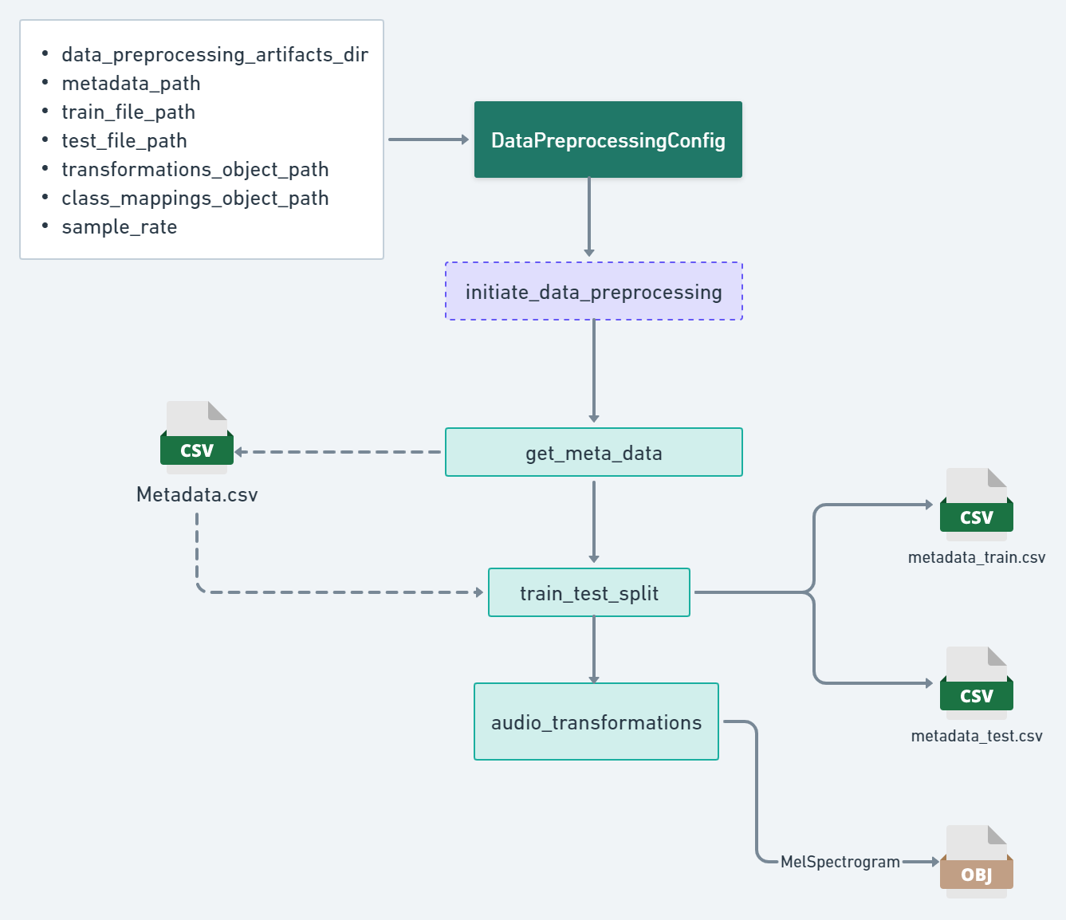

Slide 16
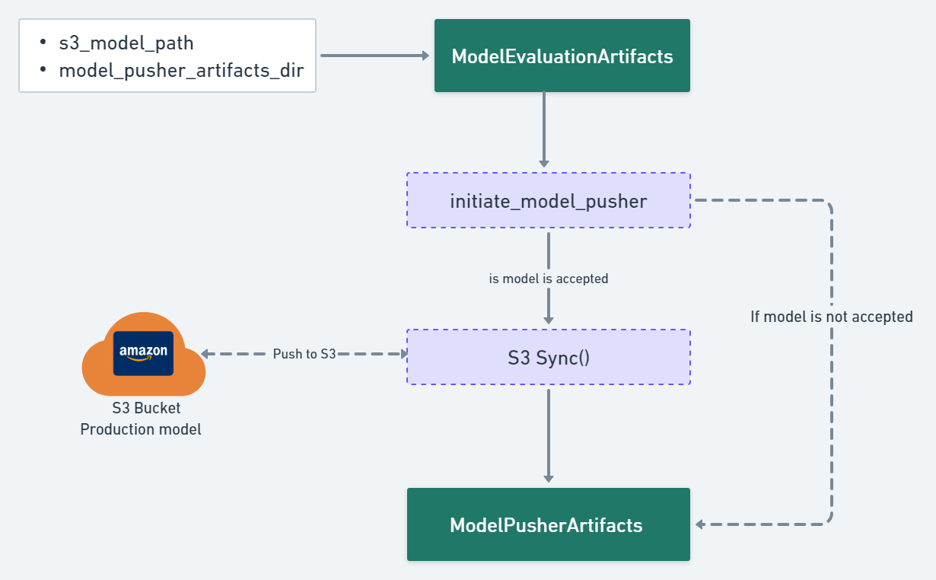

Slide 17
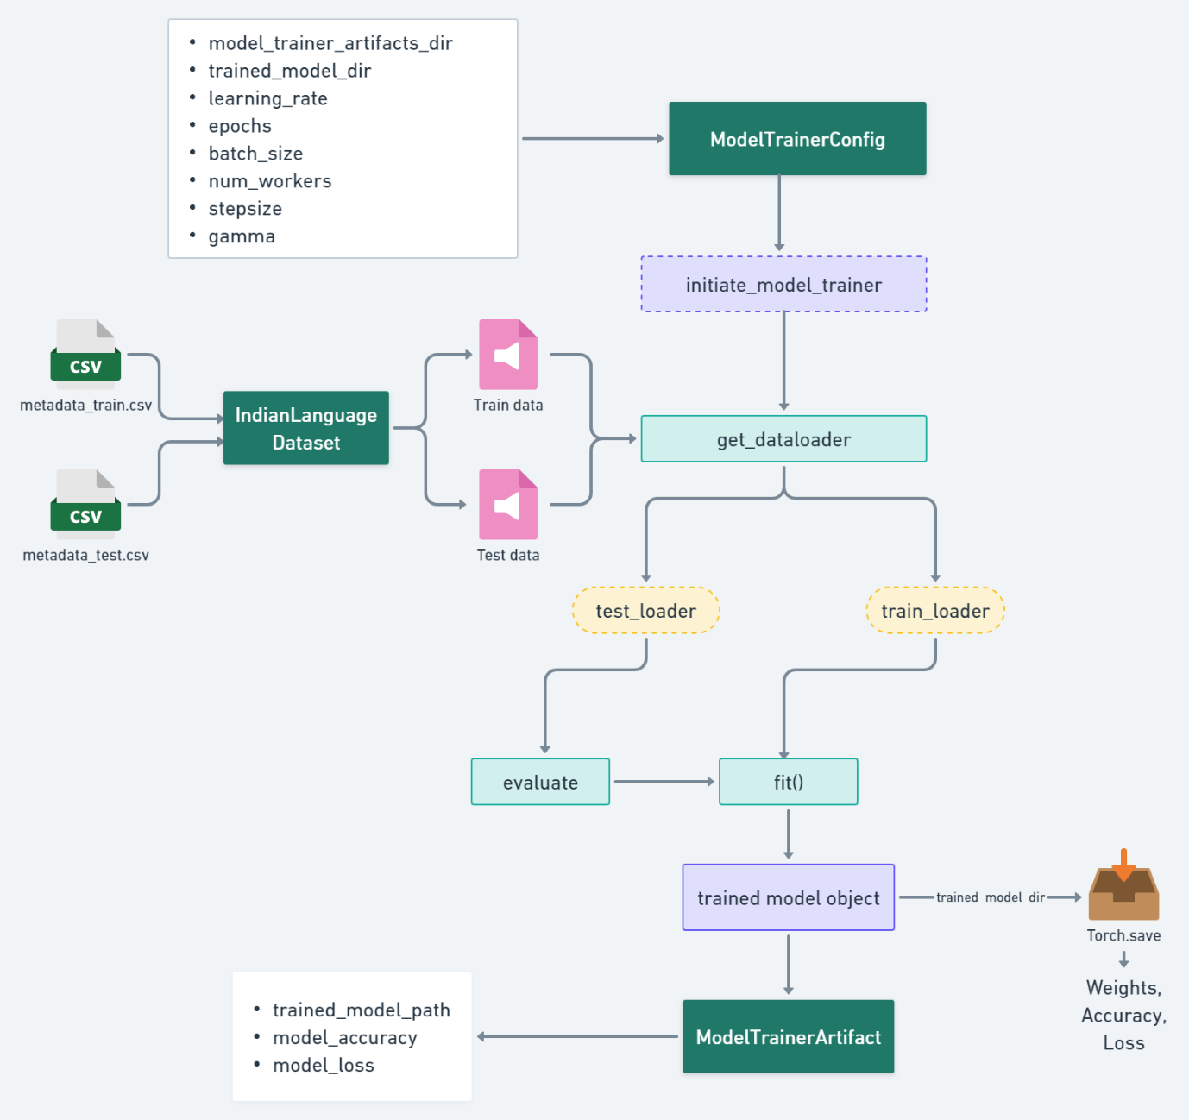

Slide 18
Future Enhancements
Strengthen the Lid system by adding more examples for each language.
Consider additional acoustic characteristics and hybrid models.
Employ incremental machine learning for continuous improvement.

